Slide 1
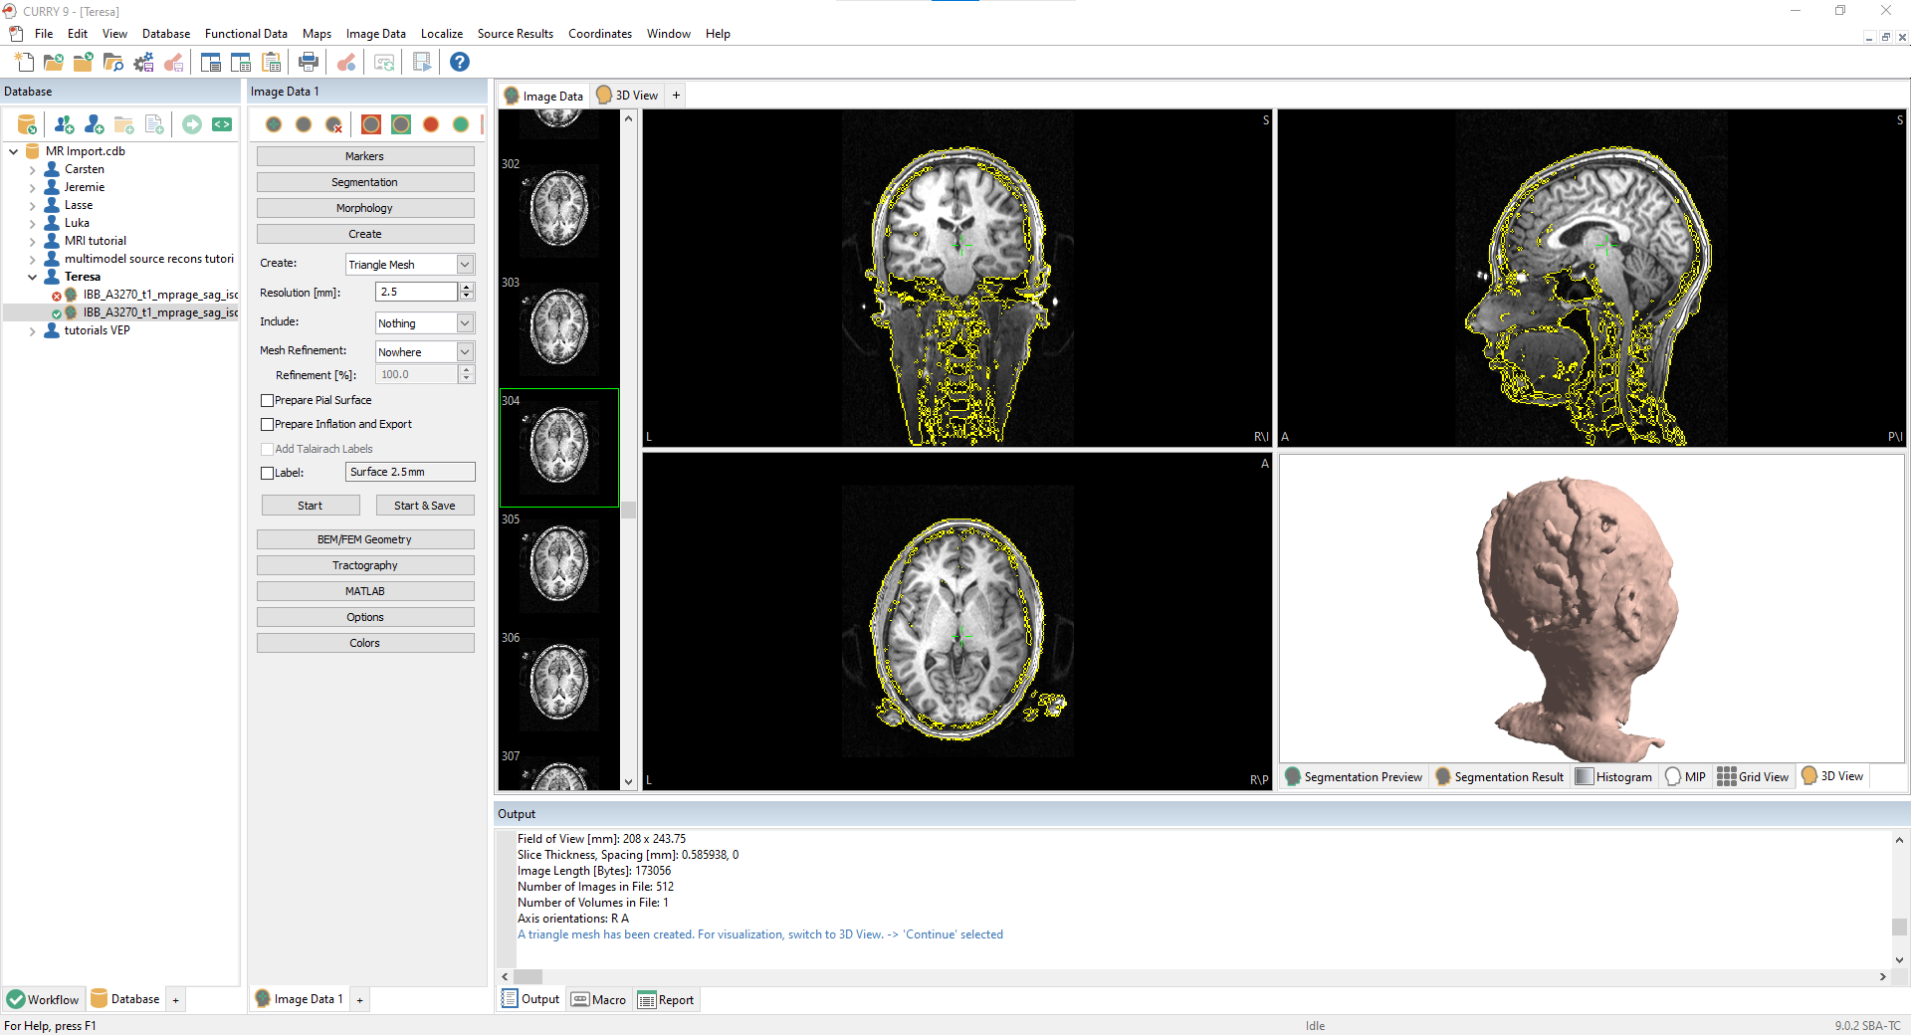

Slide 2
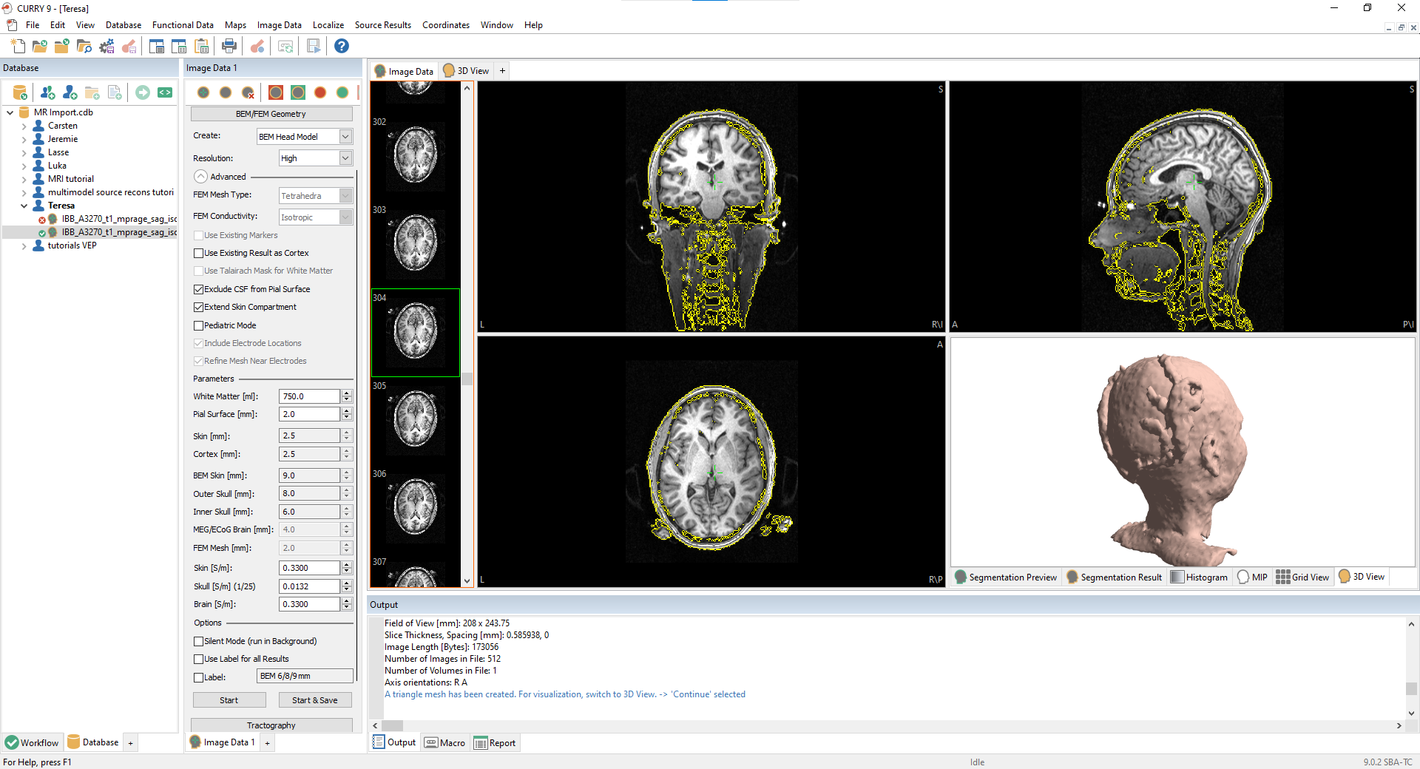

Slide 3
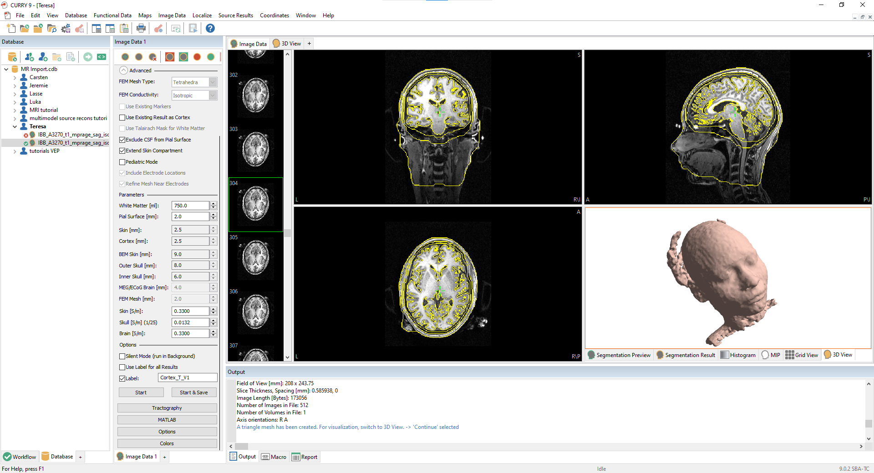

Slide 4
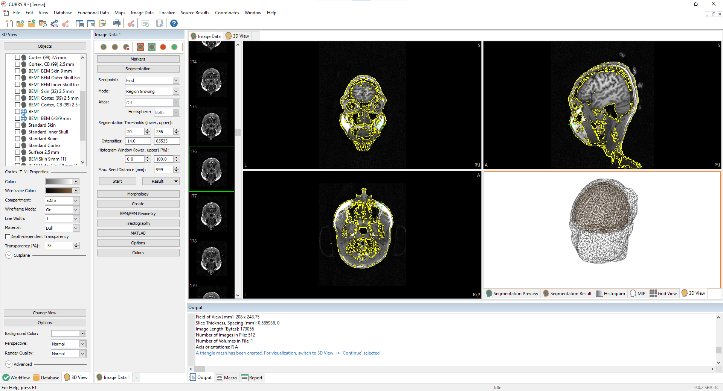

Slide 5
Draft: MRI Report

Slide 6
Step 1: Creating a BEM-Headmodel
Cortex with artifacts, growing regions compared with standard cortex
Exclude the cerebellum + brain stem a) Automated Segmentation Cortex => Error: Cerebellum still included
b) Manually Assited Automated Brain Segmentation: Brainstem and Cerebellum only partly removed => setting stop markers (limits + regions) to manually remove every layer
Result: Cortex

Slide 7
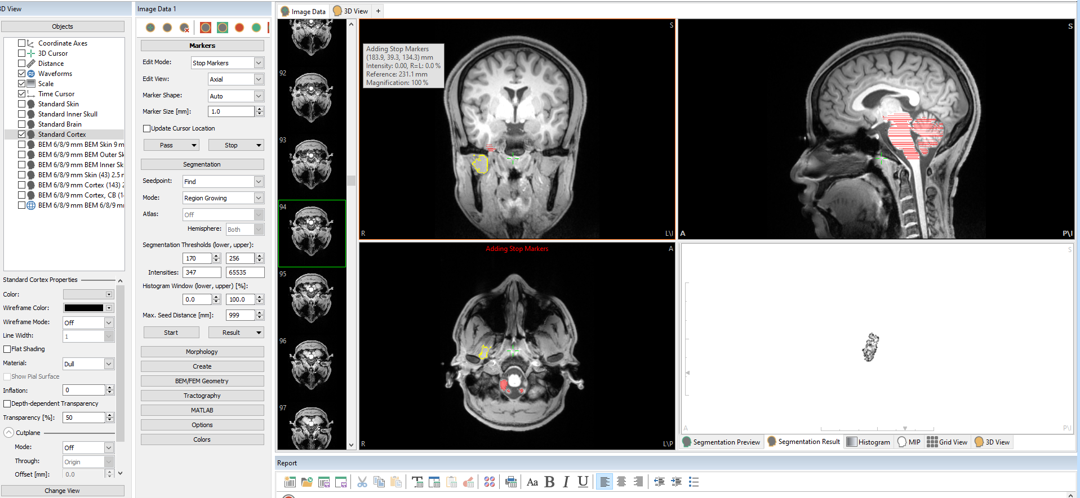
Step 1: Creating a BEM-Headmodel

Slide 8
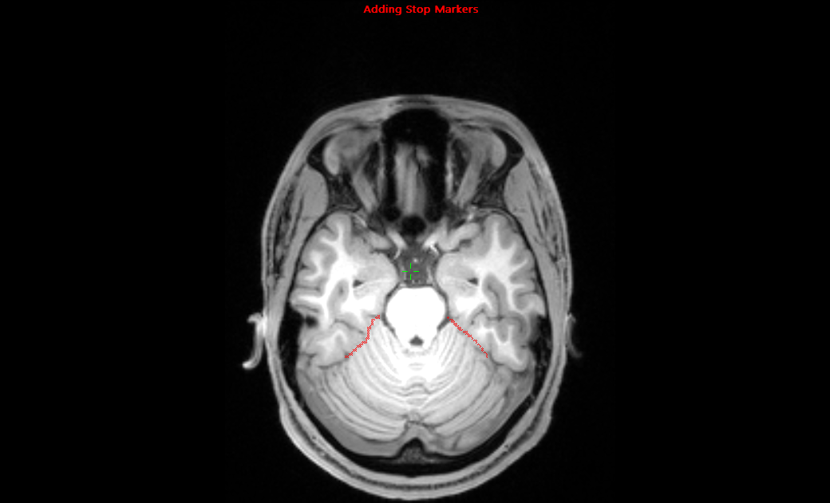
Step 1: Creating a BEM-Headmodel

Slide 9
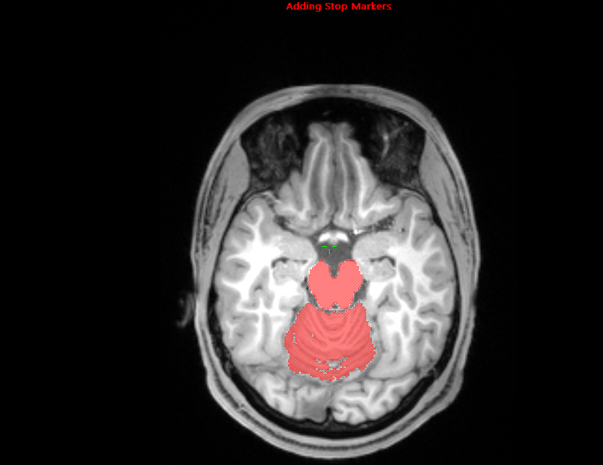
Step 1: Creating a BEM-Headmodel

Slide 10
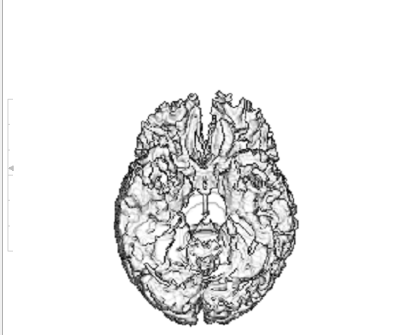
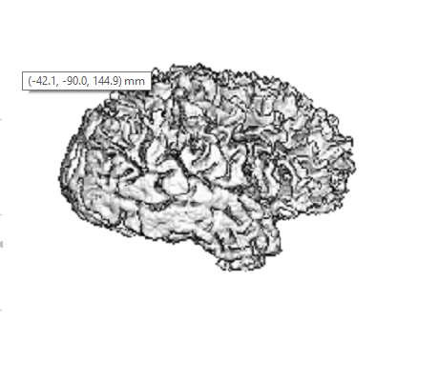
Step 1: Creating a BEM-Headmodel

Slide 11
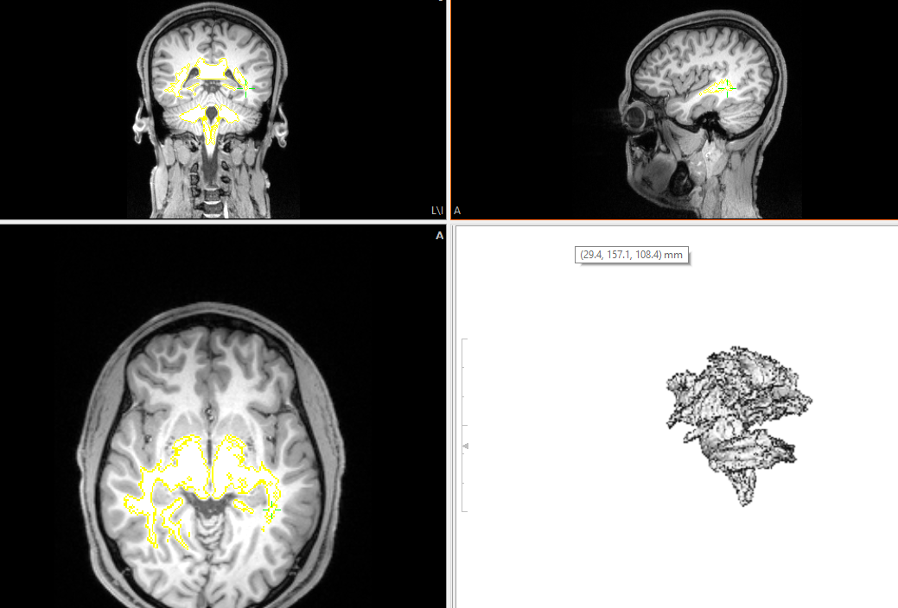
Step 1 Alternative: Adding exterior to stop markers
Lower Treshold: 68 to single out the cerebellum and brain stem => whole head preserved
Fix a) Higher treshold: cerebellum could not be completely seperated from the cortex

Slide 12
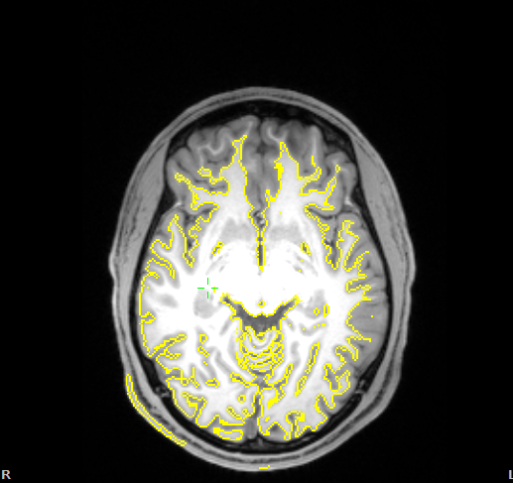
Step 1 Alternative: Adding exterior to stop markers
Fix b) manual segmentation
=> Exclusion of cortex areas in bi-frontal and right parietal regions

Slide 13
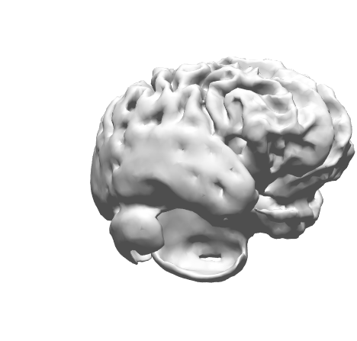
Step 1: Second Alternative
Start from scratch
A) Automated BEM Head Model Generation
Result: Cortex plus parts of the cerebellum and errors in temporal lobe

Slide 14
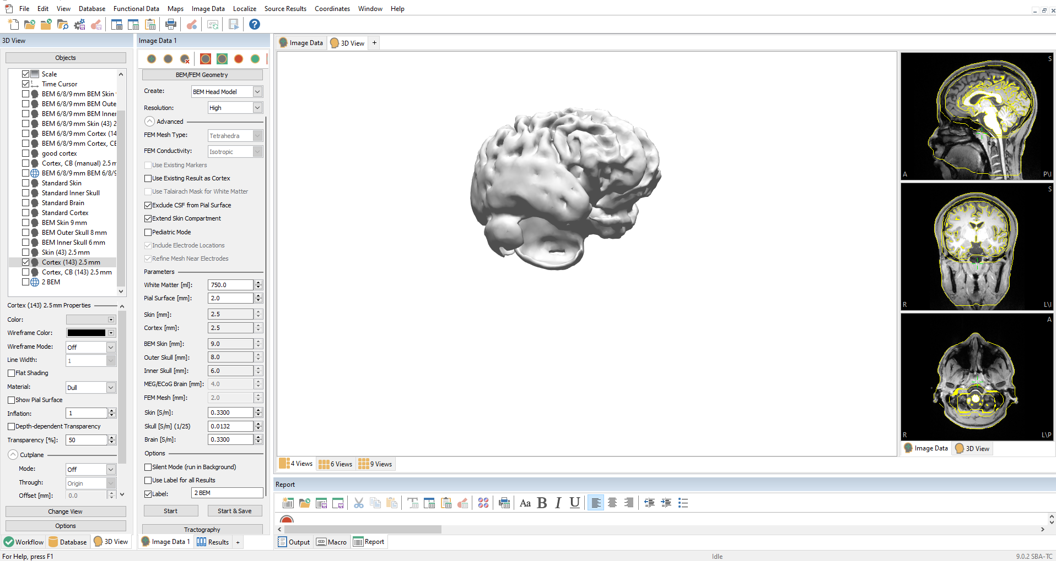

Slide 15
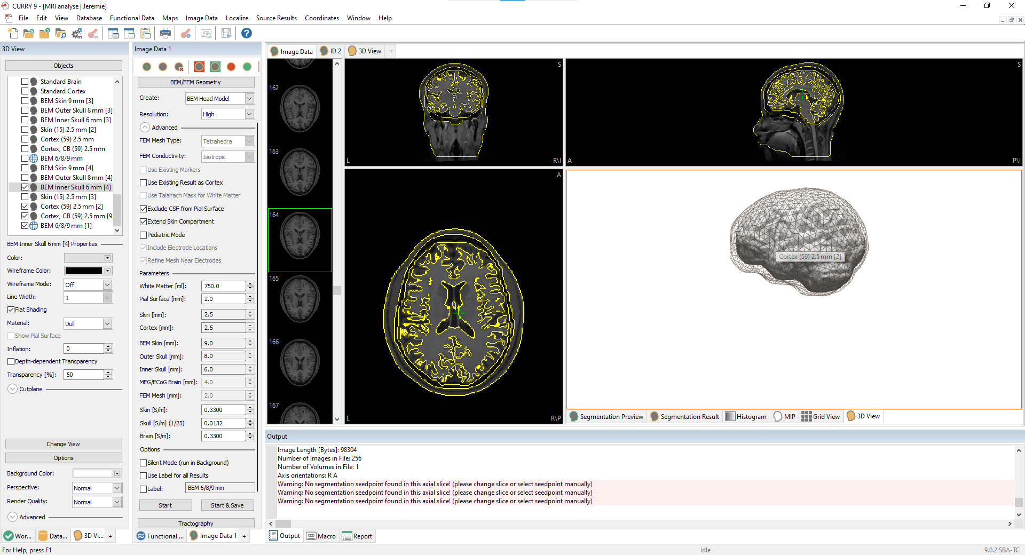
BEM Head Model Creation
Notes:
Note: Algor. (Seg. & BEM Head Model)

Slide 16
MEG EEG
Artifact Reduction(voltage threshold to detect Blink artifacts ,
Averaging()

Slide 17
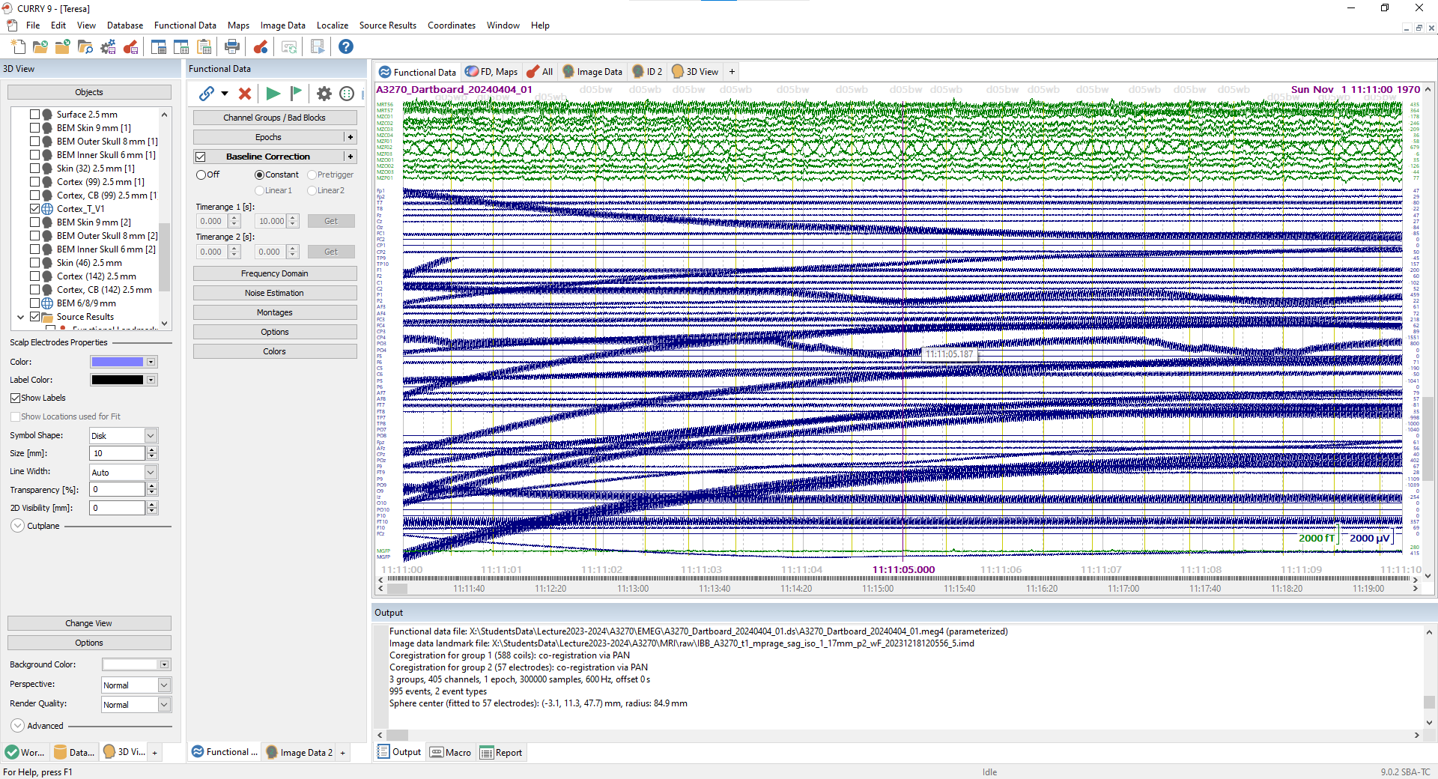
Teresa EMEG Data
Notes:
lot of weird channels

Slide 18
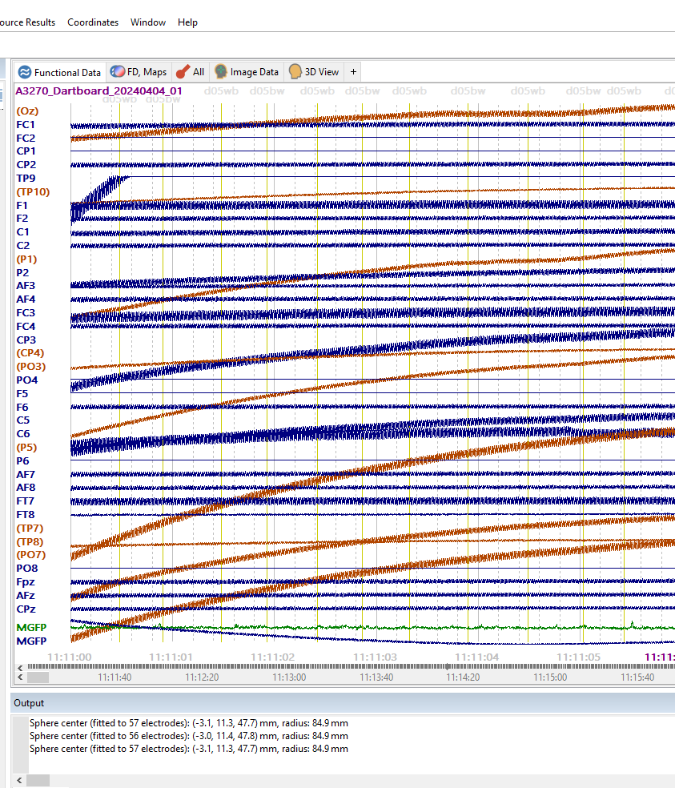
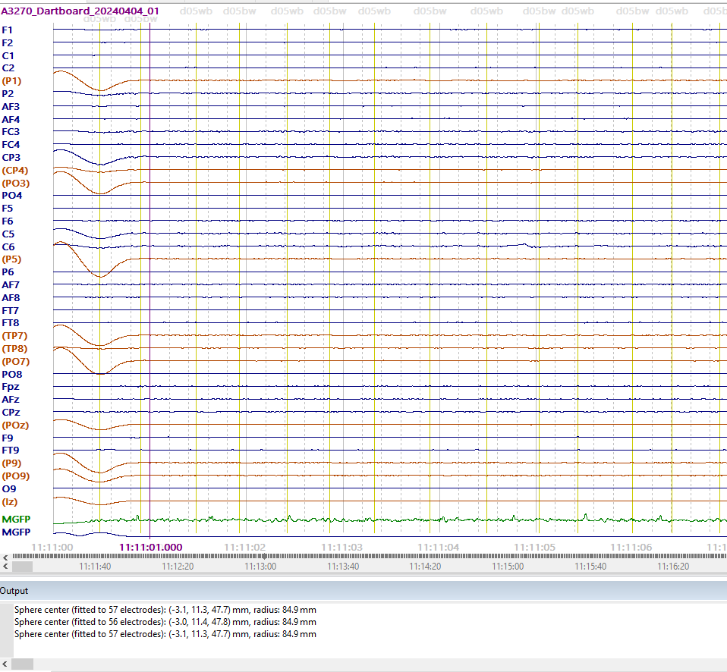
Channel Interpolation
& Filtering
Notes:
After interpolating channel. Need to filter out high frequency

Slide 19
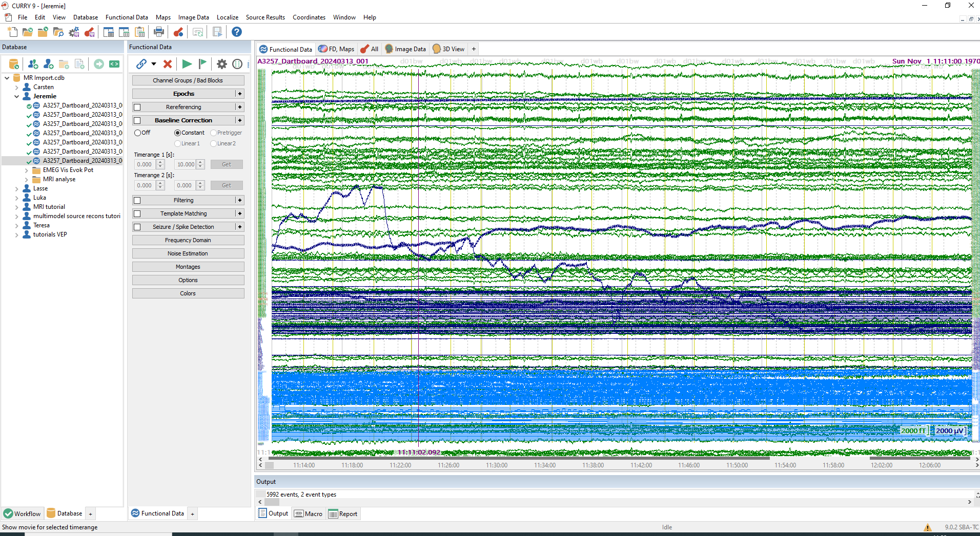

Jeremie EMEG Data
Notes:
Few EEG Channels (FT7, FT8, lz, FC2) with extrapolated signal. We will interpolate (4 Neighbours) after applying a constant baseline correction

Slide 20
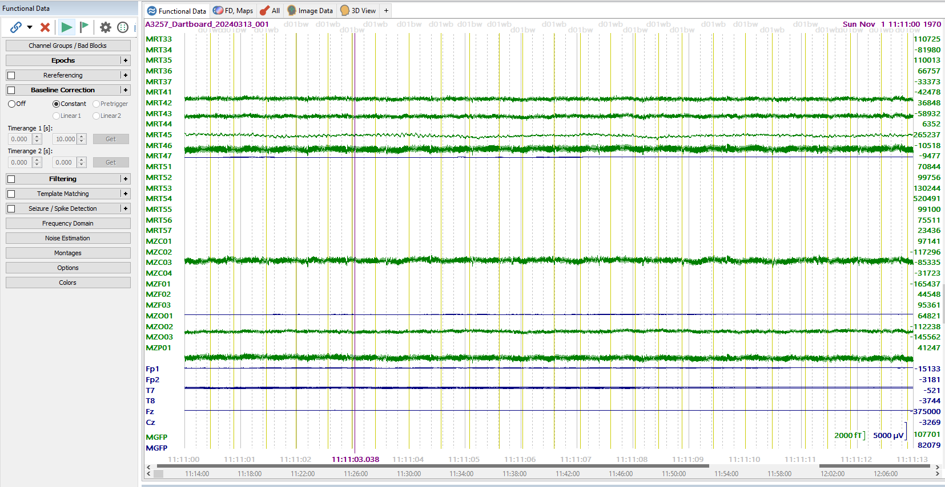
Before Baseline Correction
Notes:
file was recorded with no High Pass filtering (DC), it is common to see varying degrees of DC offset, thus the large numbers for the voltages on the far right. In Curry, the DC offset can also be removed by performing a Baseline Correction, with Constant for Type

Slide 21
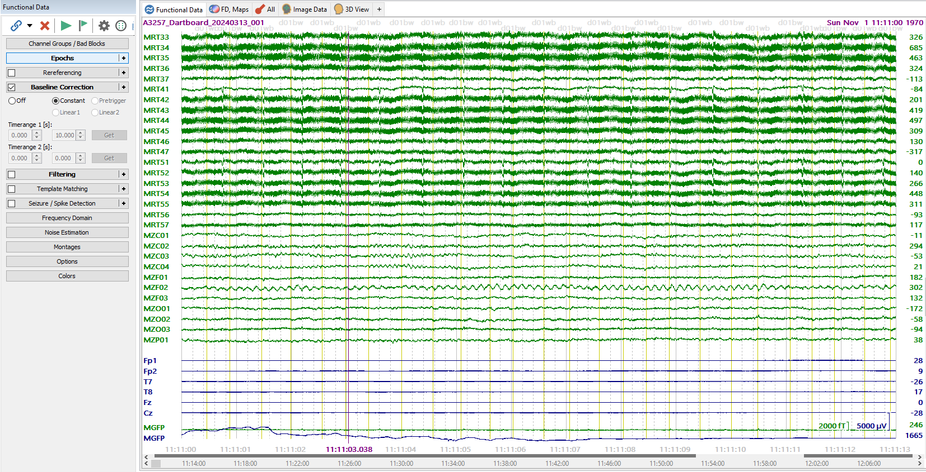
After Baseline Correction

Slide 22
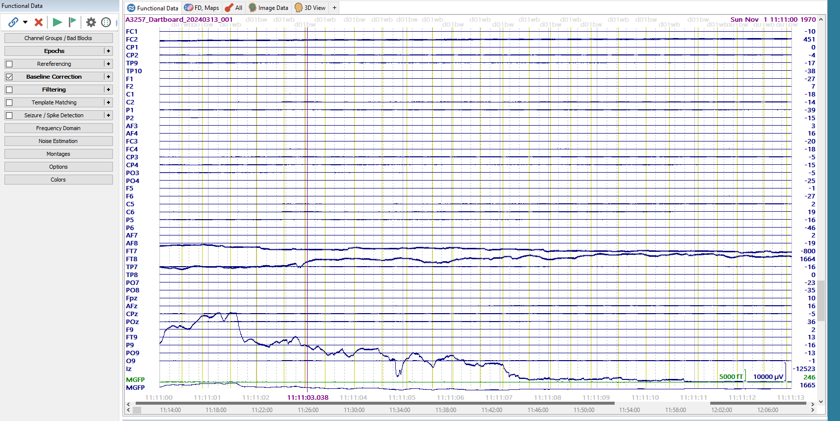
Before Channel Interpolation
Notes:
EEG Channels (FT7, FT8, lz, FC2) with extrapolated signal. We will interpolate (4 Neighbours)

Slide 23
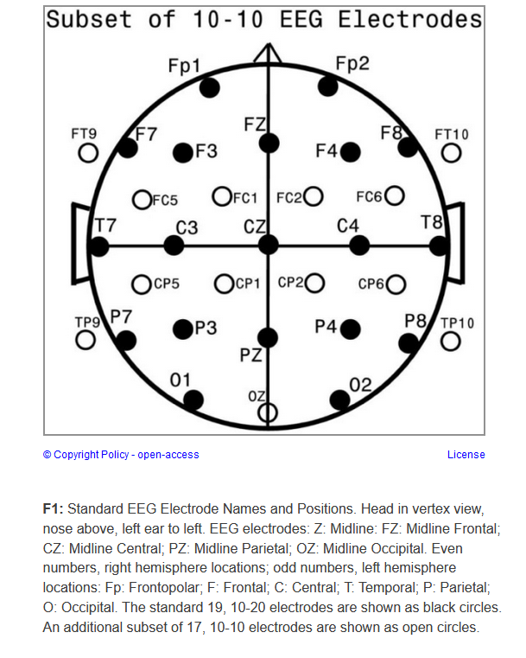
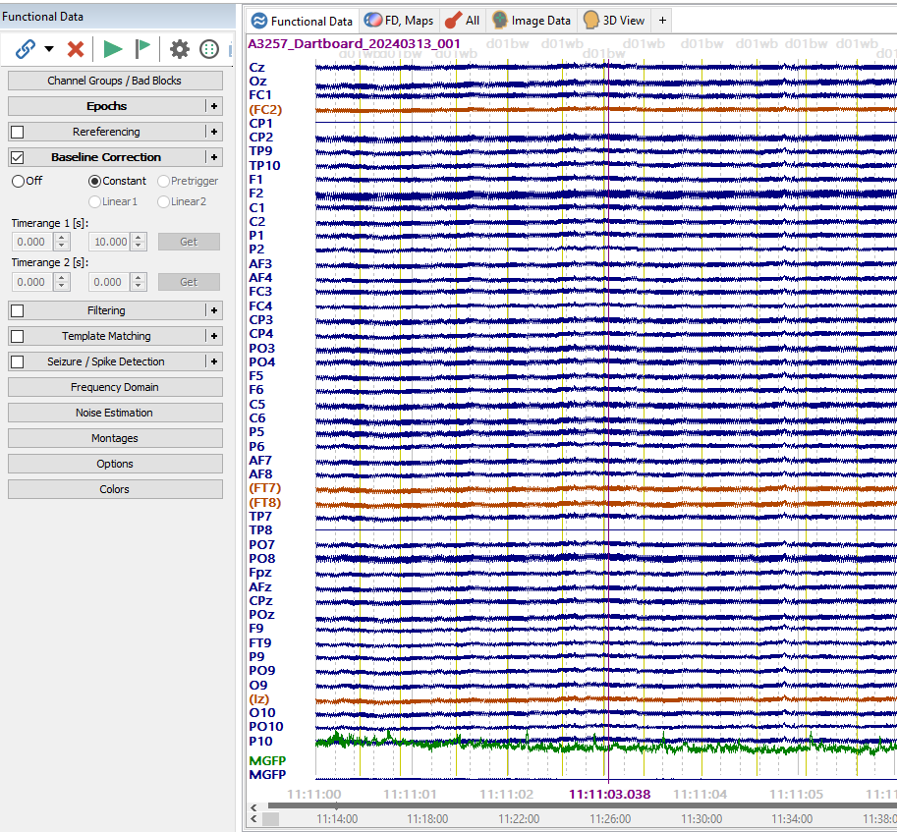
After Channel Interpolation
Notes:
Baseline Correction and Channel Interpolation

Slide 24
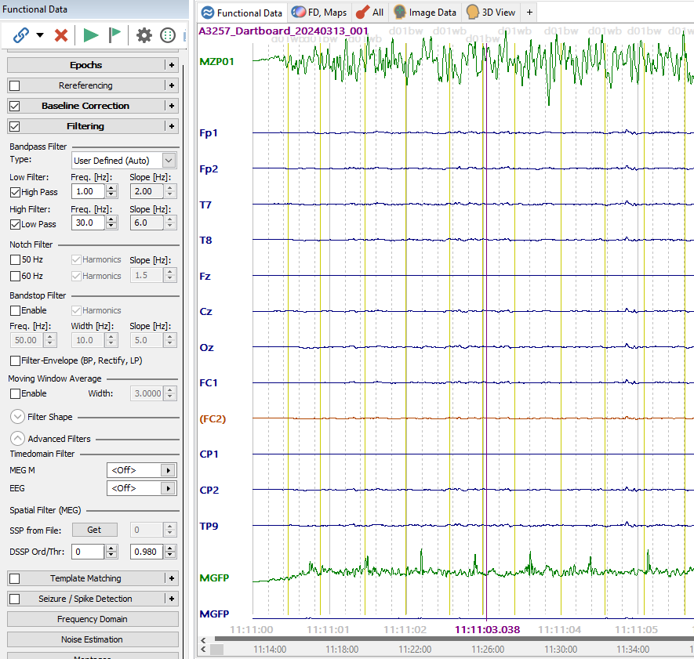
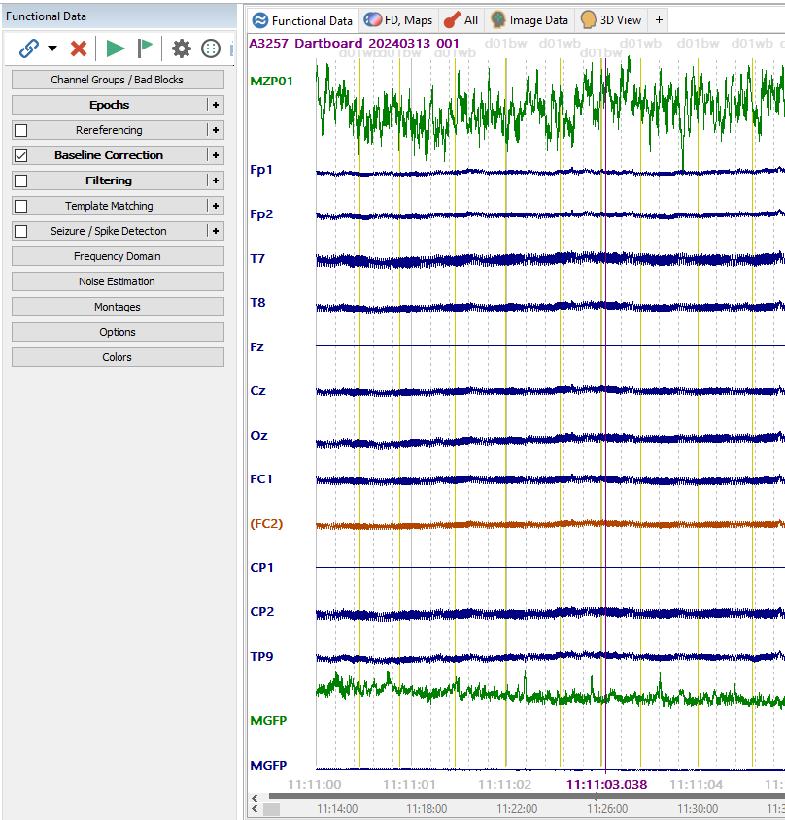
After Default Filtering
Before Default Filtering
Notes:
Baseline Correction and Channel Interpolation

Slide 25
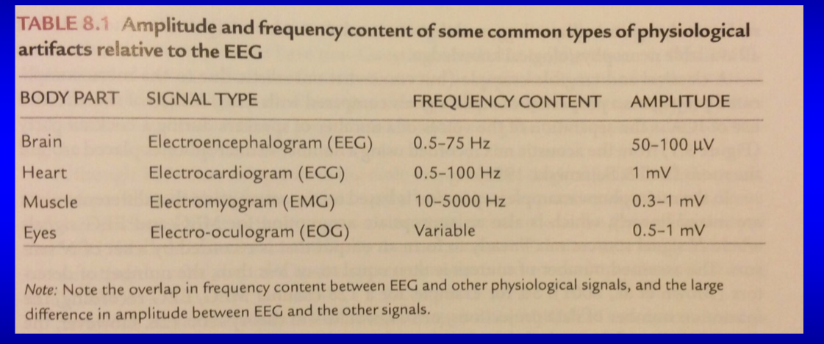
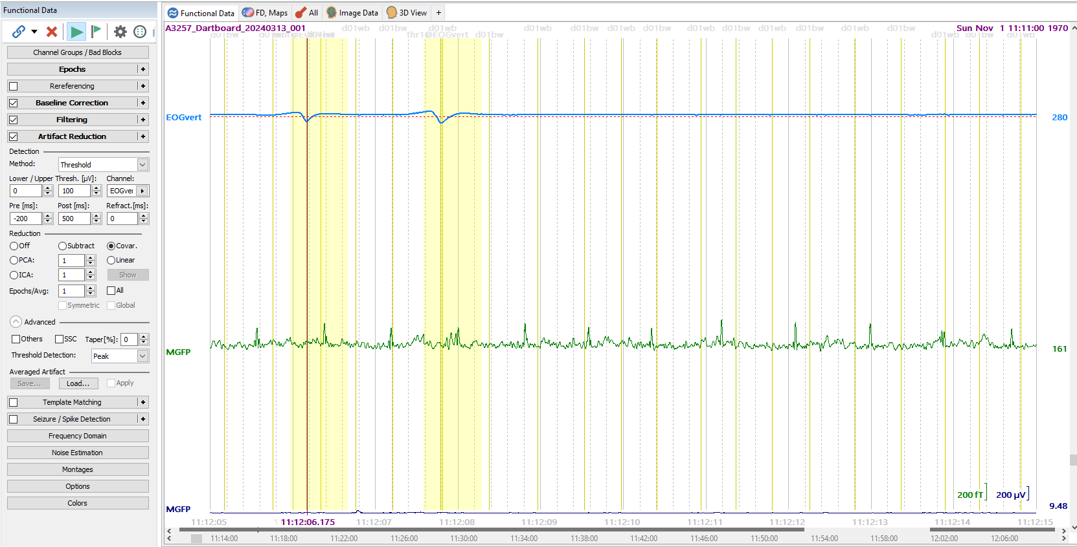
Blink Artifact Detection: Voltage Threshold
Notes:
Before Filtering, detect blink artifact using voltage Threshold. Select Threshold value and the eye Channel

Slide 26
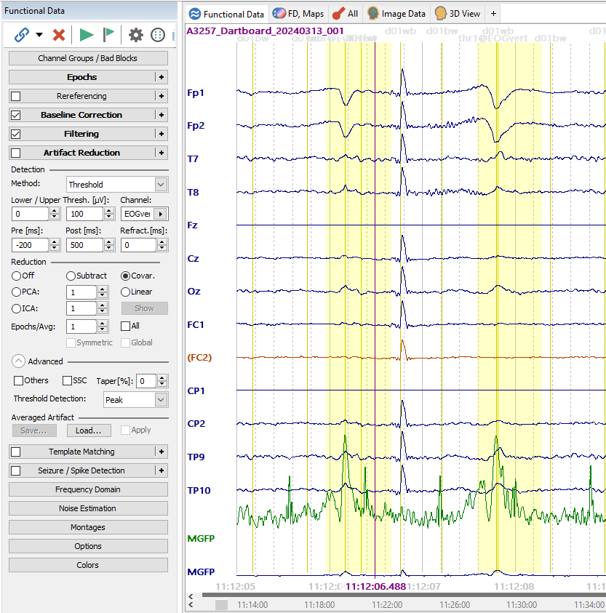
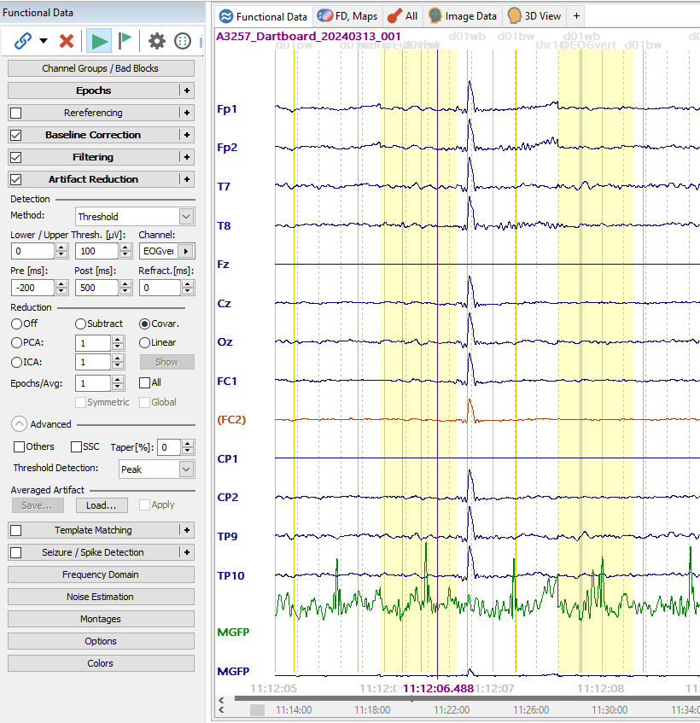
Before Blink Reduction
After Blink Reduction
Notes:
Here reduction with Covariance. Data Filters needs to be used here. Change could also be seen in the Butterfly display.
PCA (Principle Component Analysis) or ICA also reduce the blink artifact. Blink is the first component. So 1 is enough to remove blink artifacts.
Could also perform Template Matching and PCA projection (must enable CAR as referencing to see effect)

Slide 27
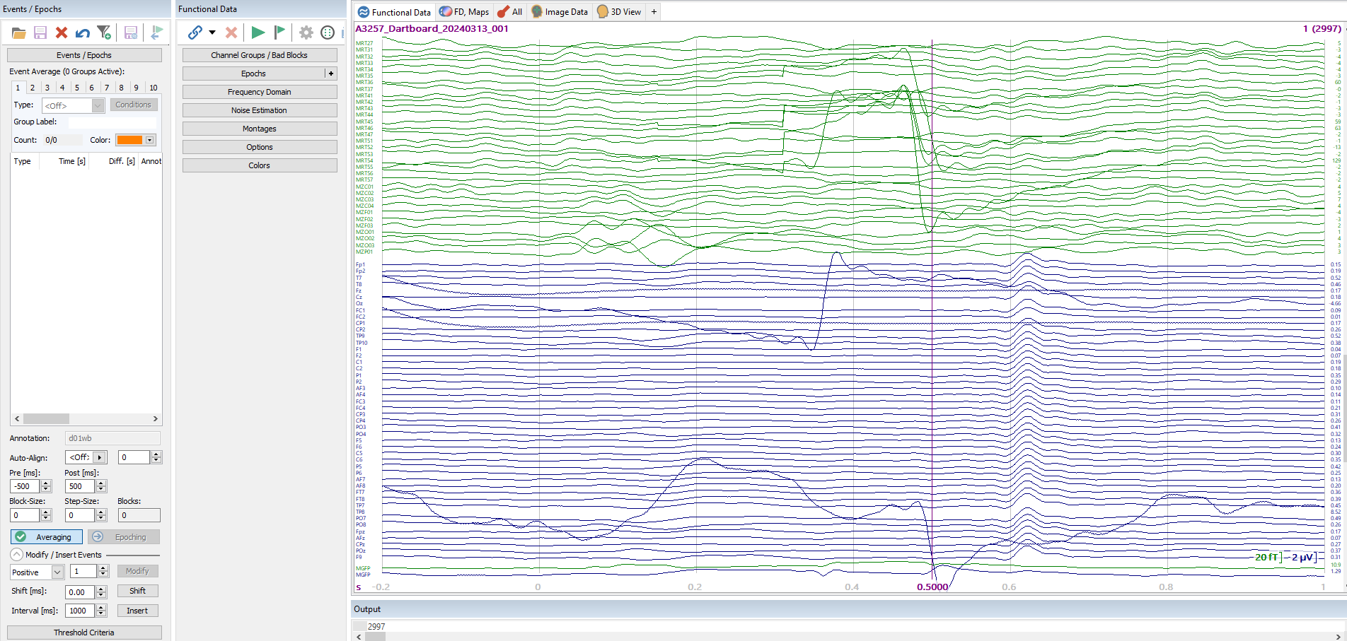
Average Data

Slide 28
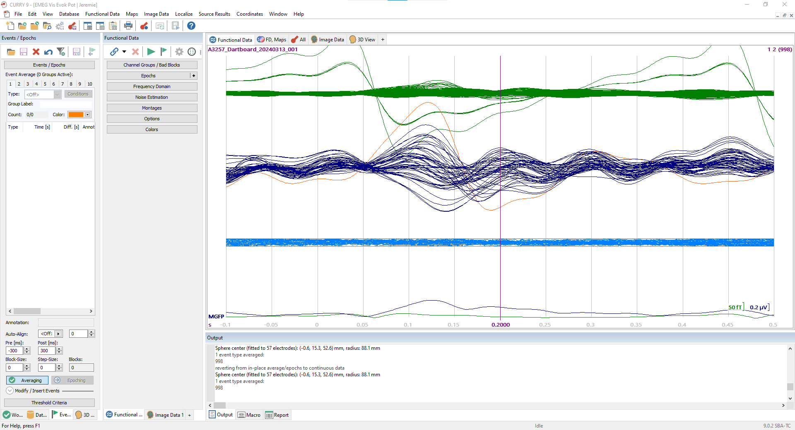
Averaged Signal in Butterfly Plot

Slide 29
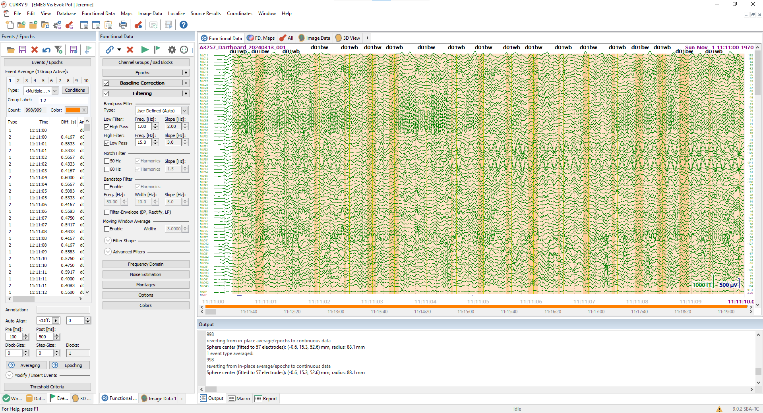
Filter Adjustment - Filter 2 ( 1- 15)

Slide 30
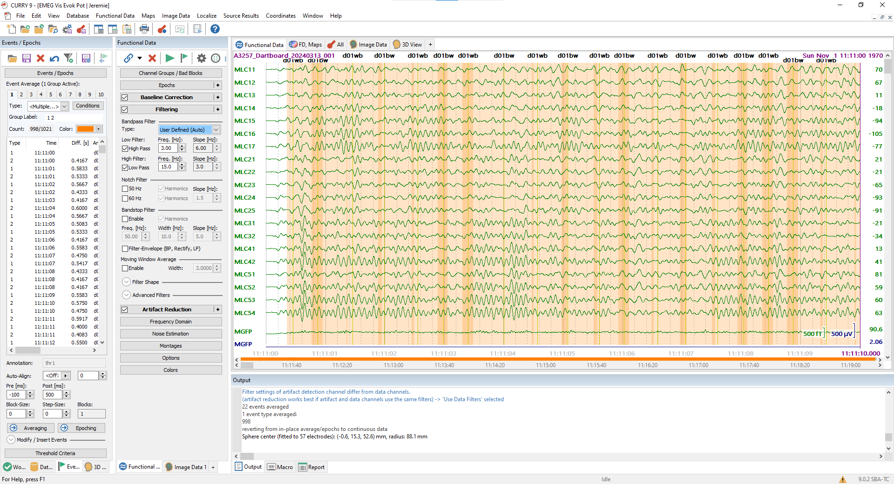
High Pass adj. 3 Hz

Slide 31
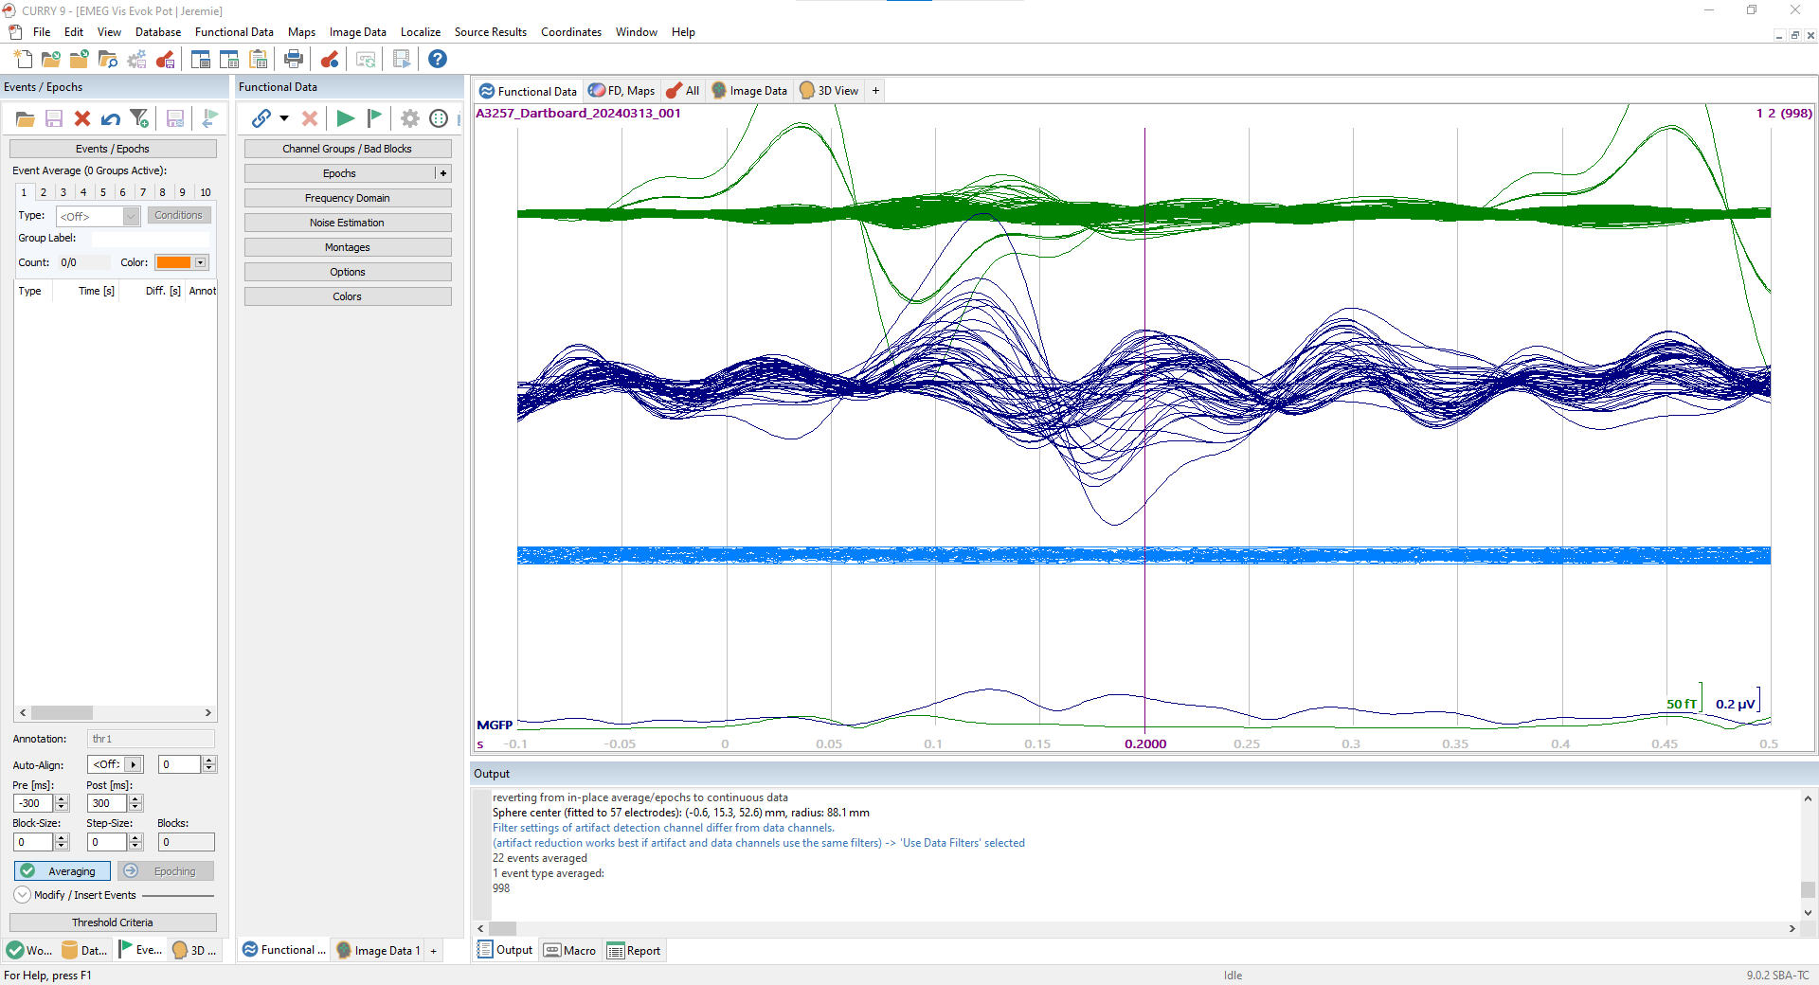
Newly Filtered & Averaged Butterfly Plot

Slide 32
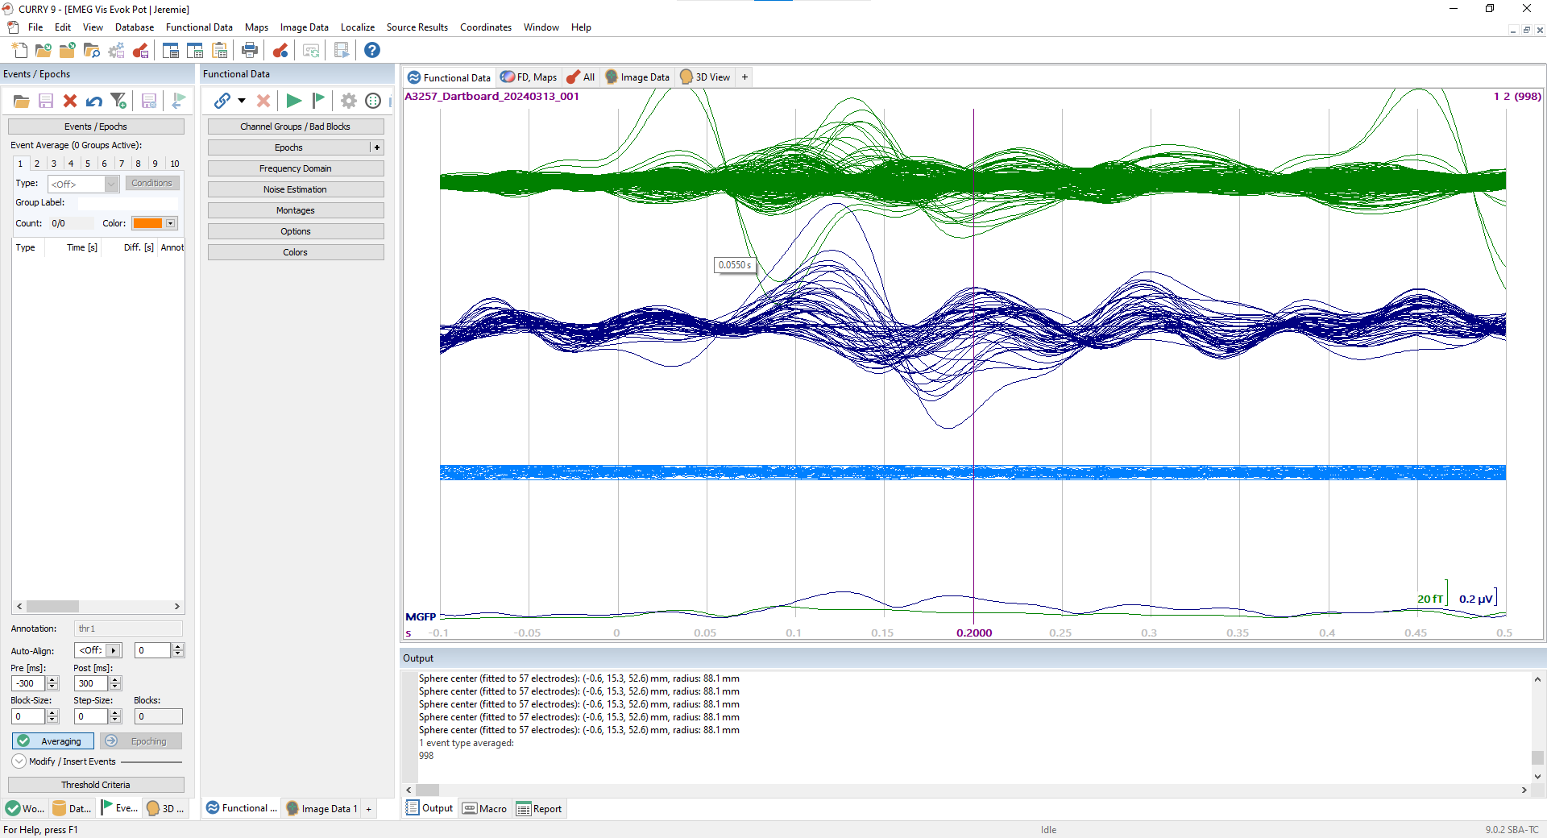
With Interpolated channels
Notes:
No satisfying improvement. So we removed them

Slide 33
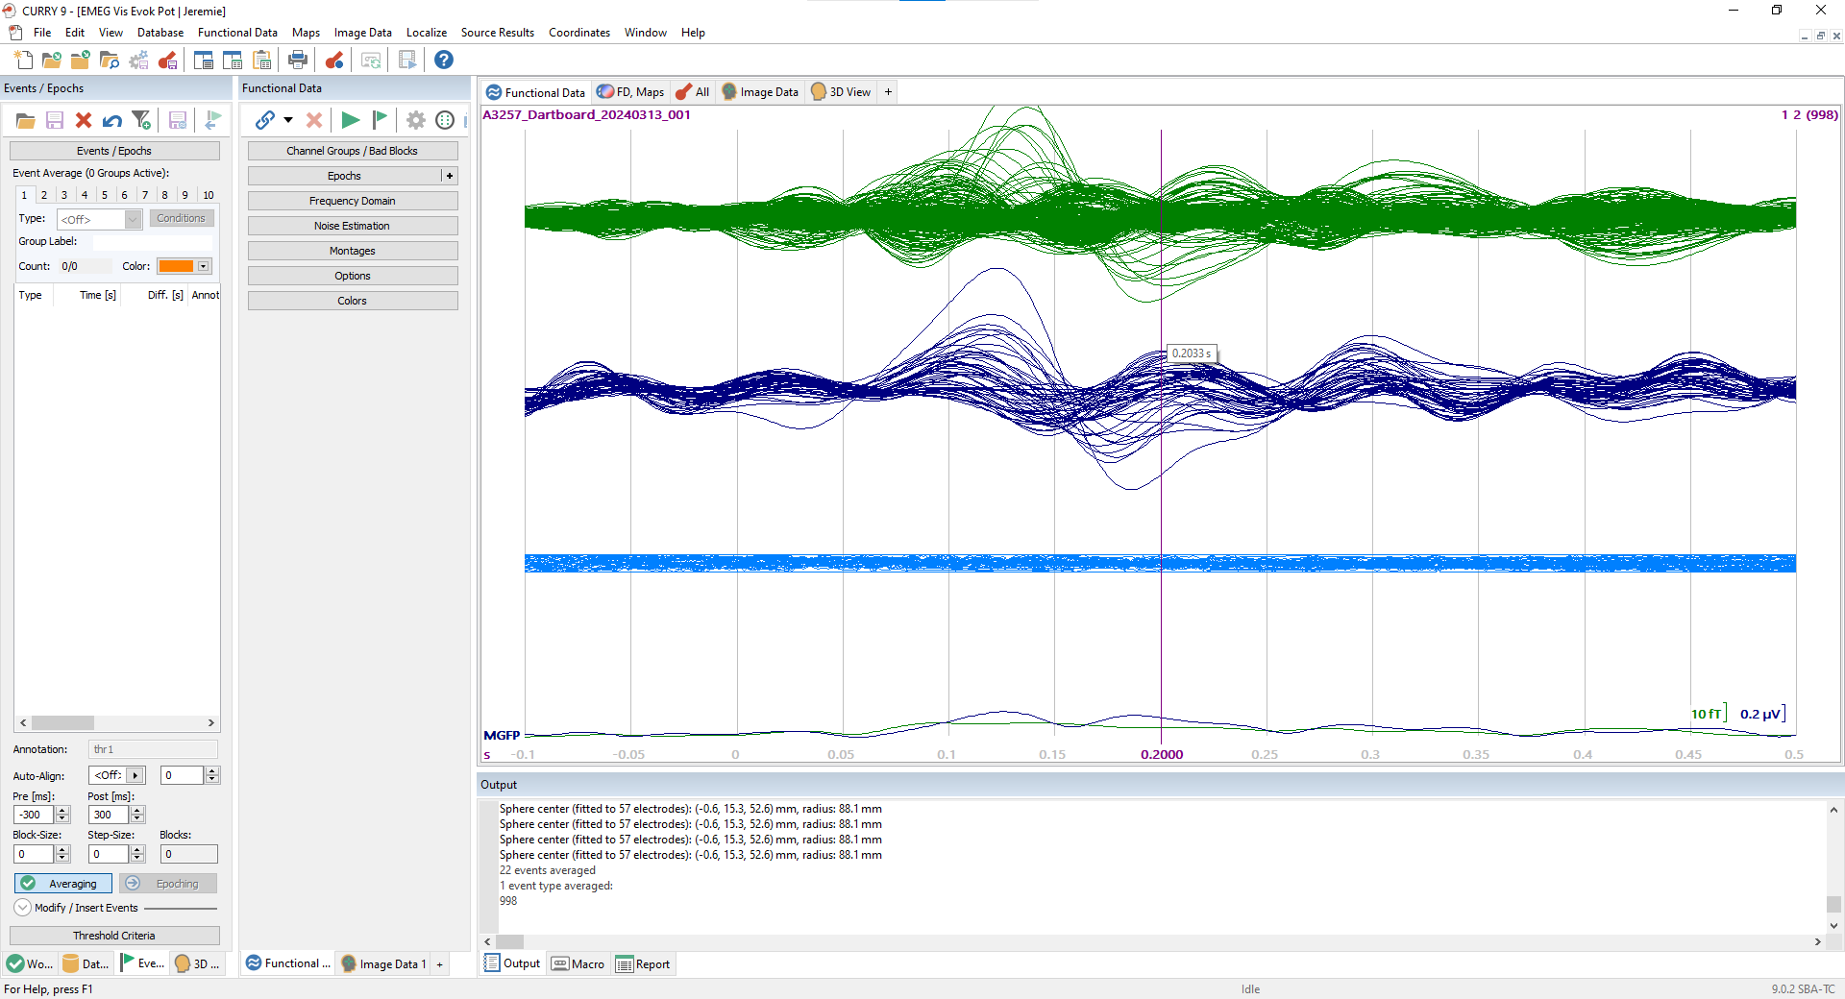
With Desactivated channels

Slide 34
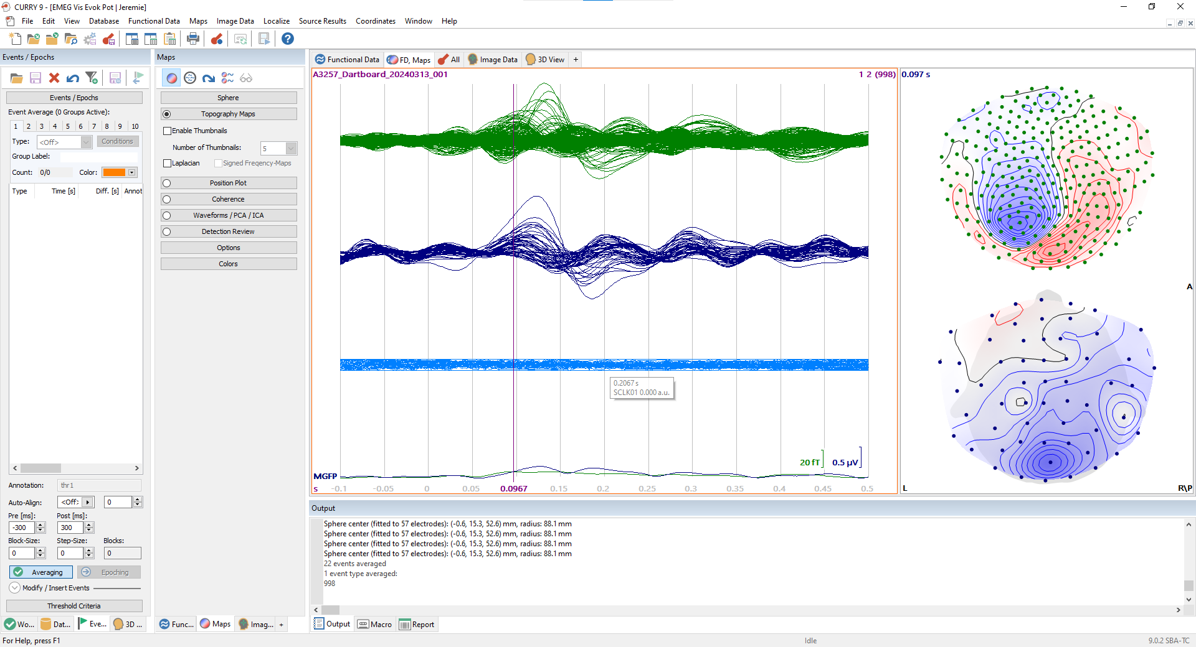
FD Maps

Slide 35
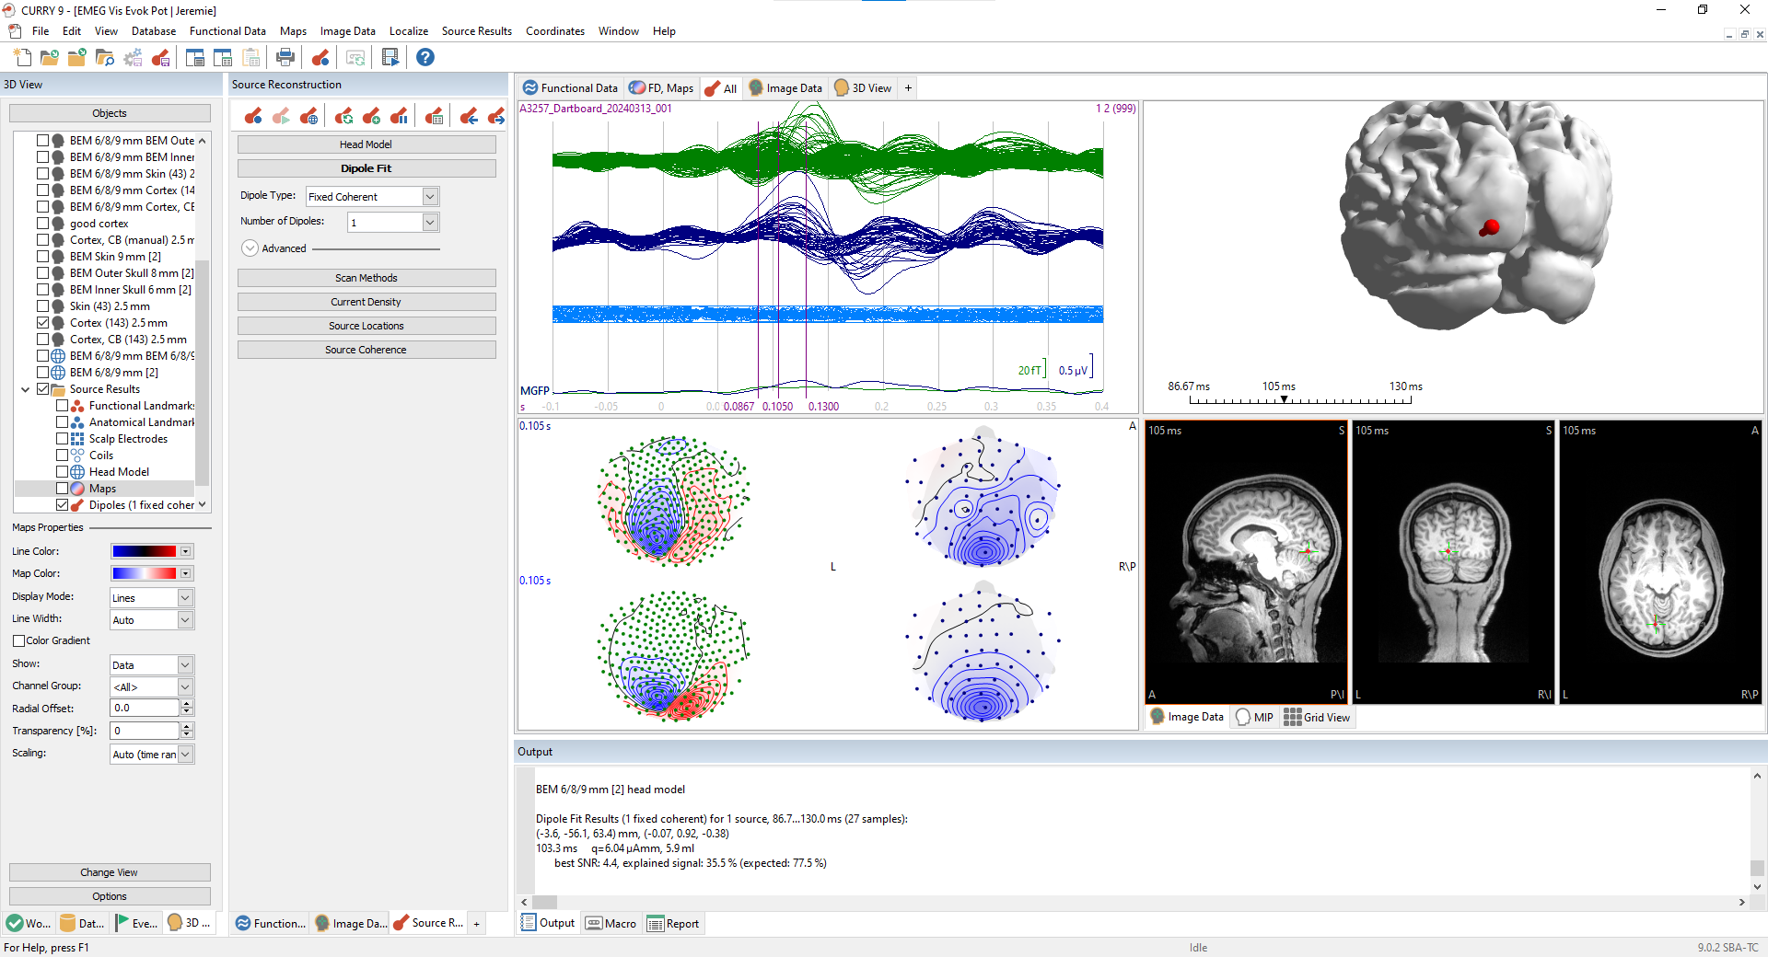
Start Emil

Slide 36
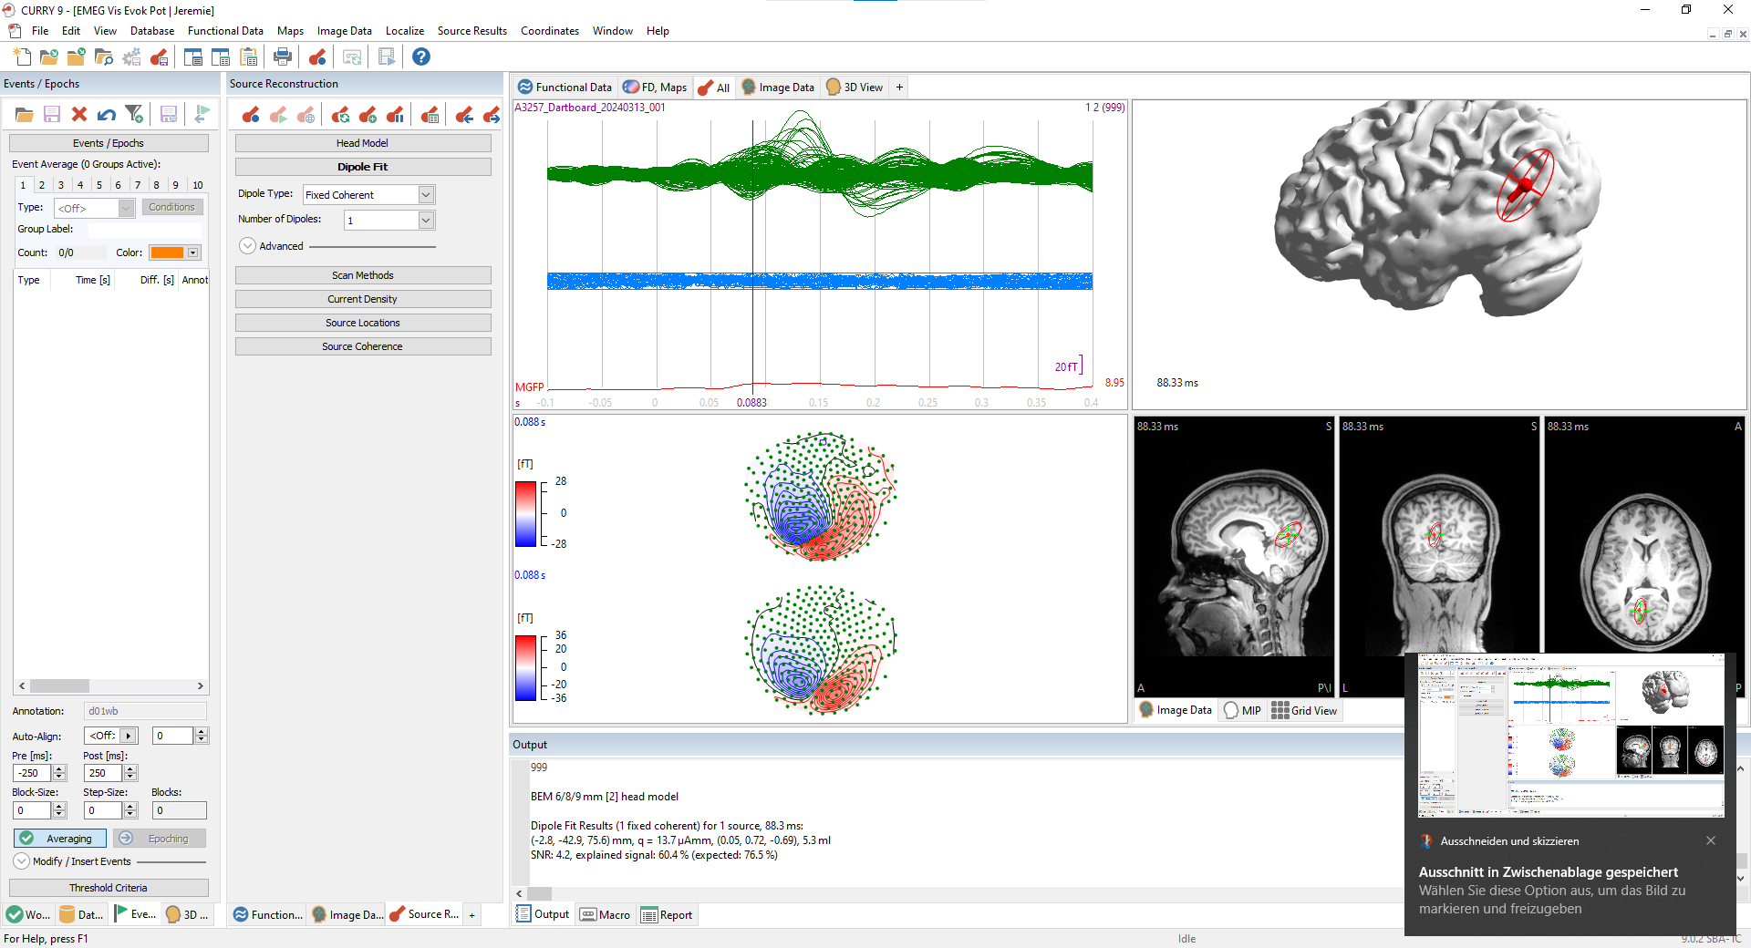

Slide 37
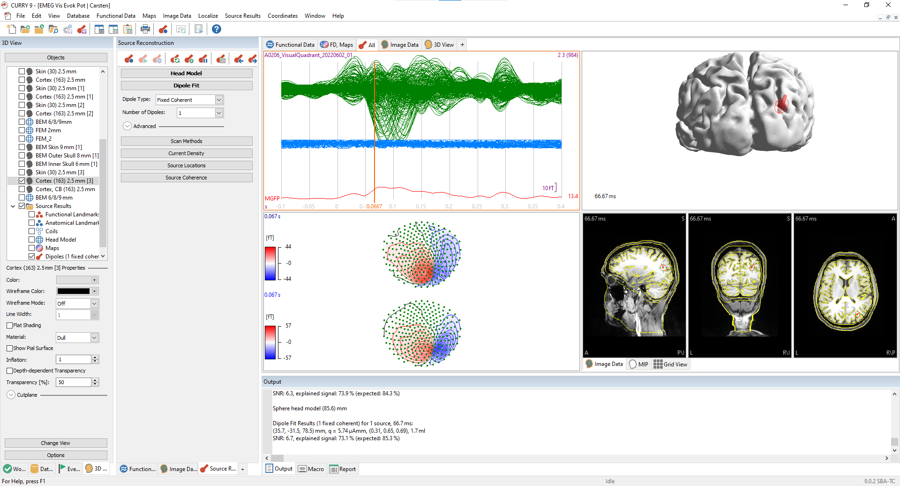
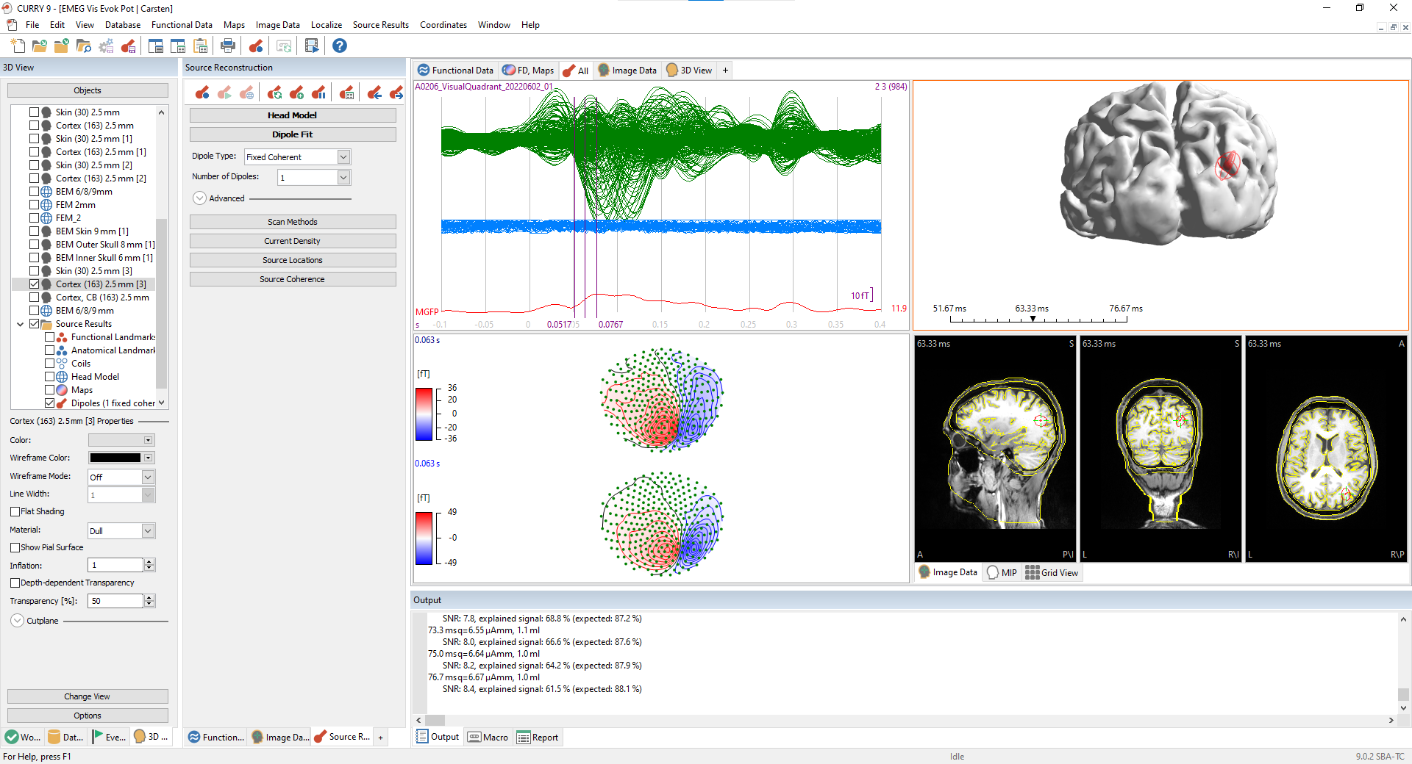
Carsten MEG only

Slide 38
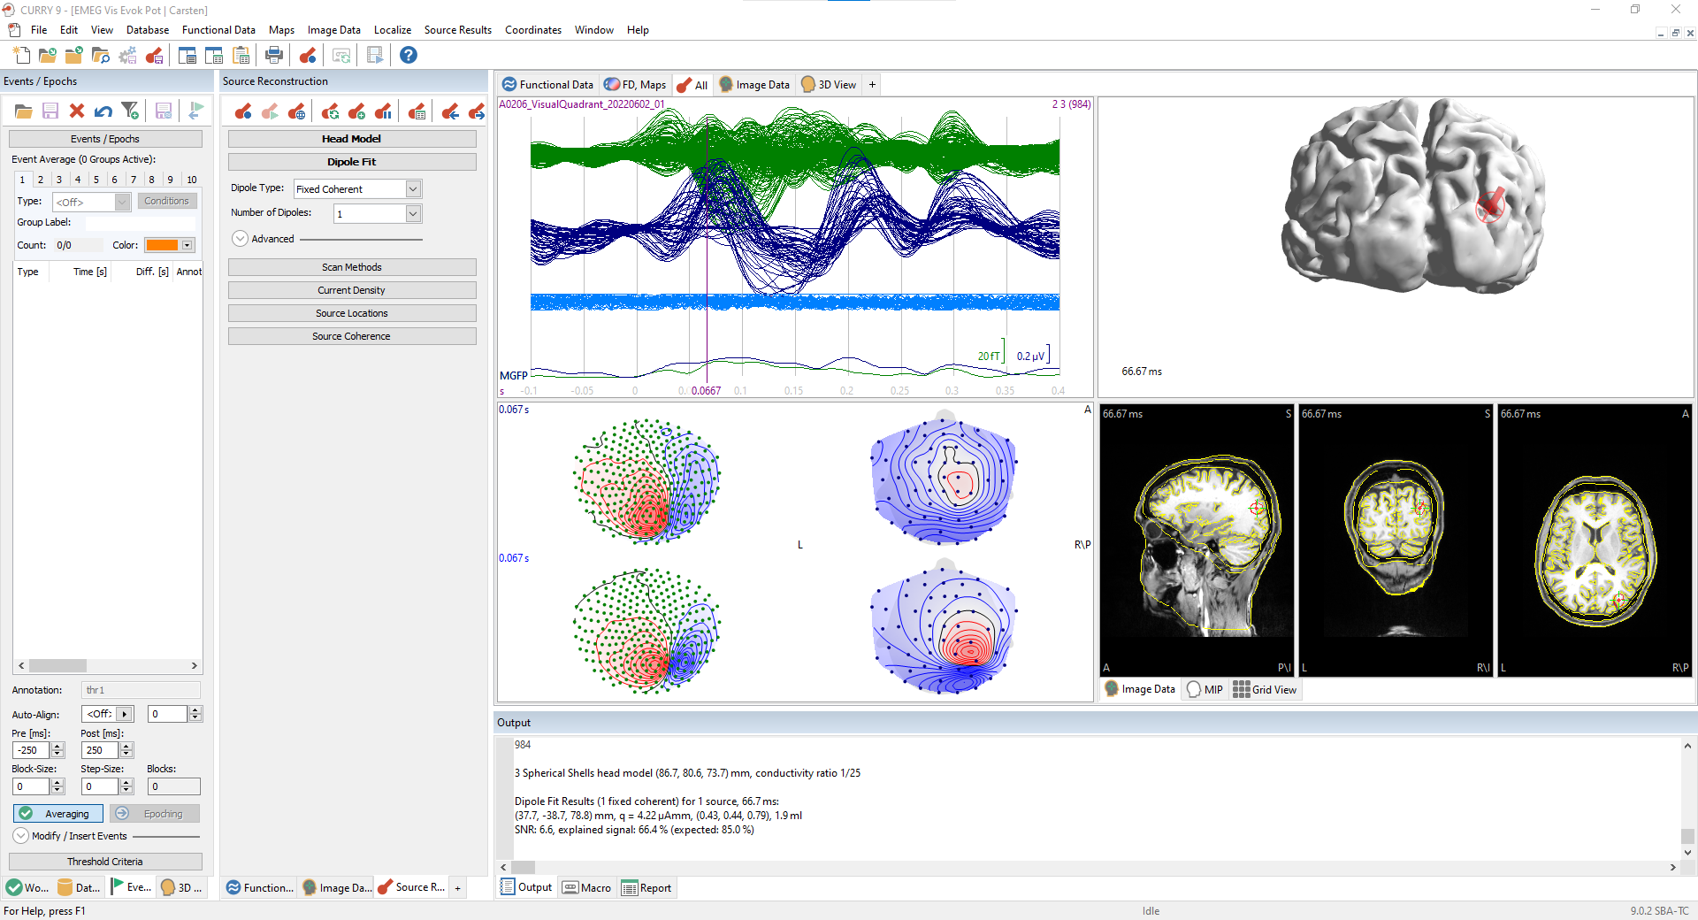
Carsten EMEG

Slide 39
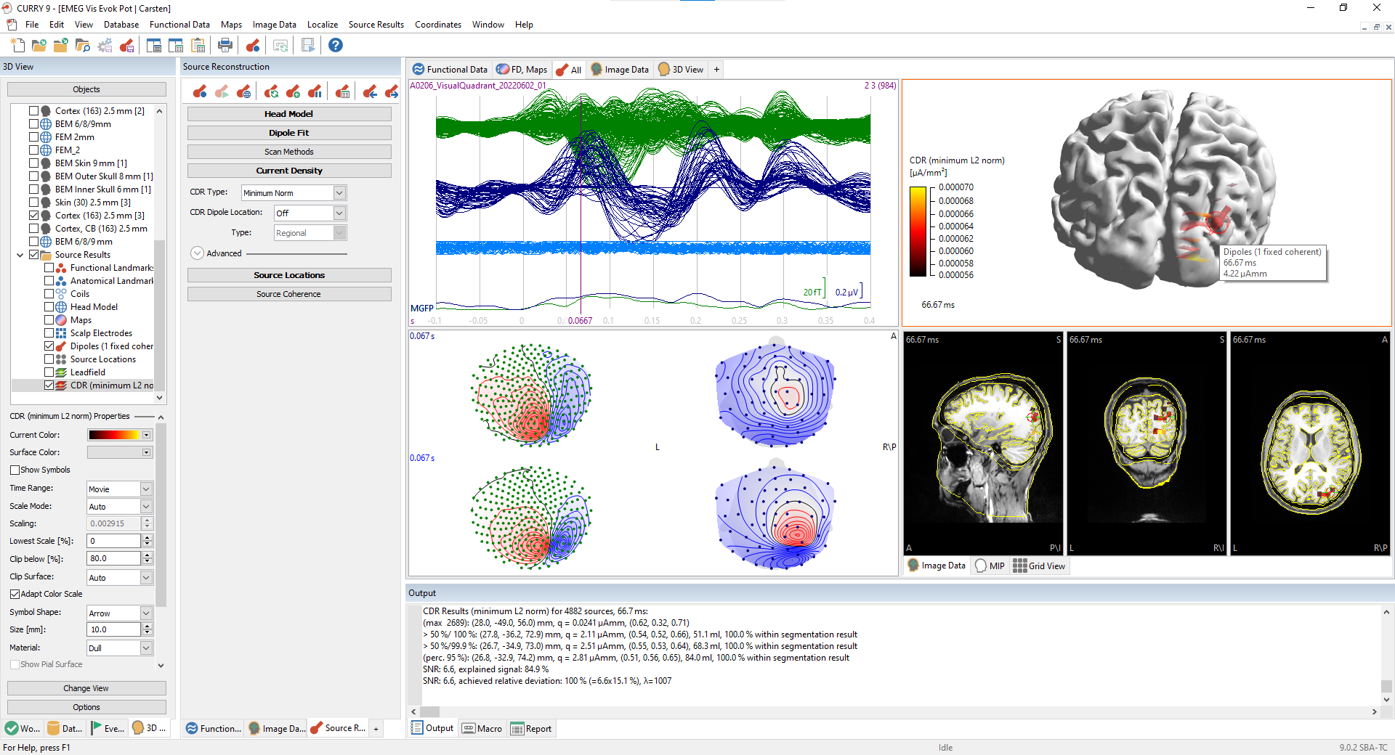
Minimum Norm CDR

Slide 40

sLORETA CDR

Slide 41
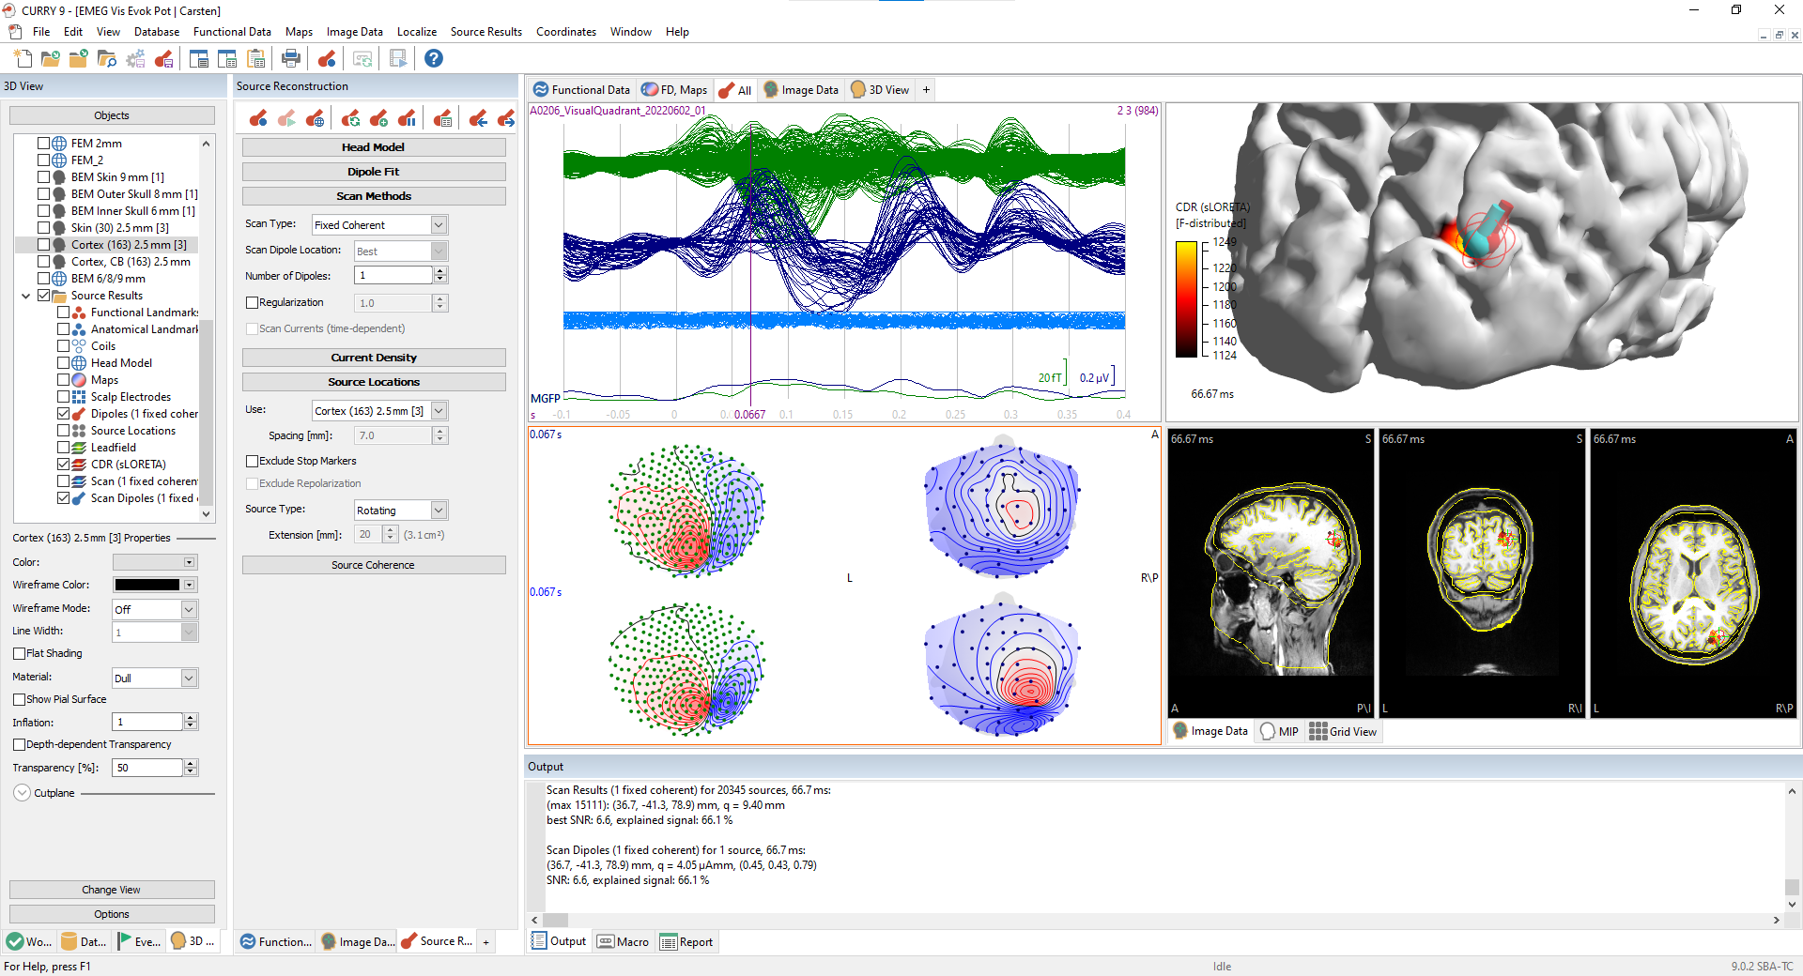
Dipole scan

Slide 42
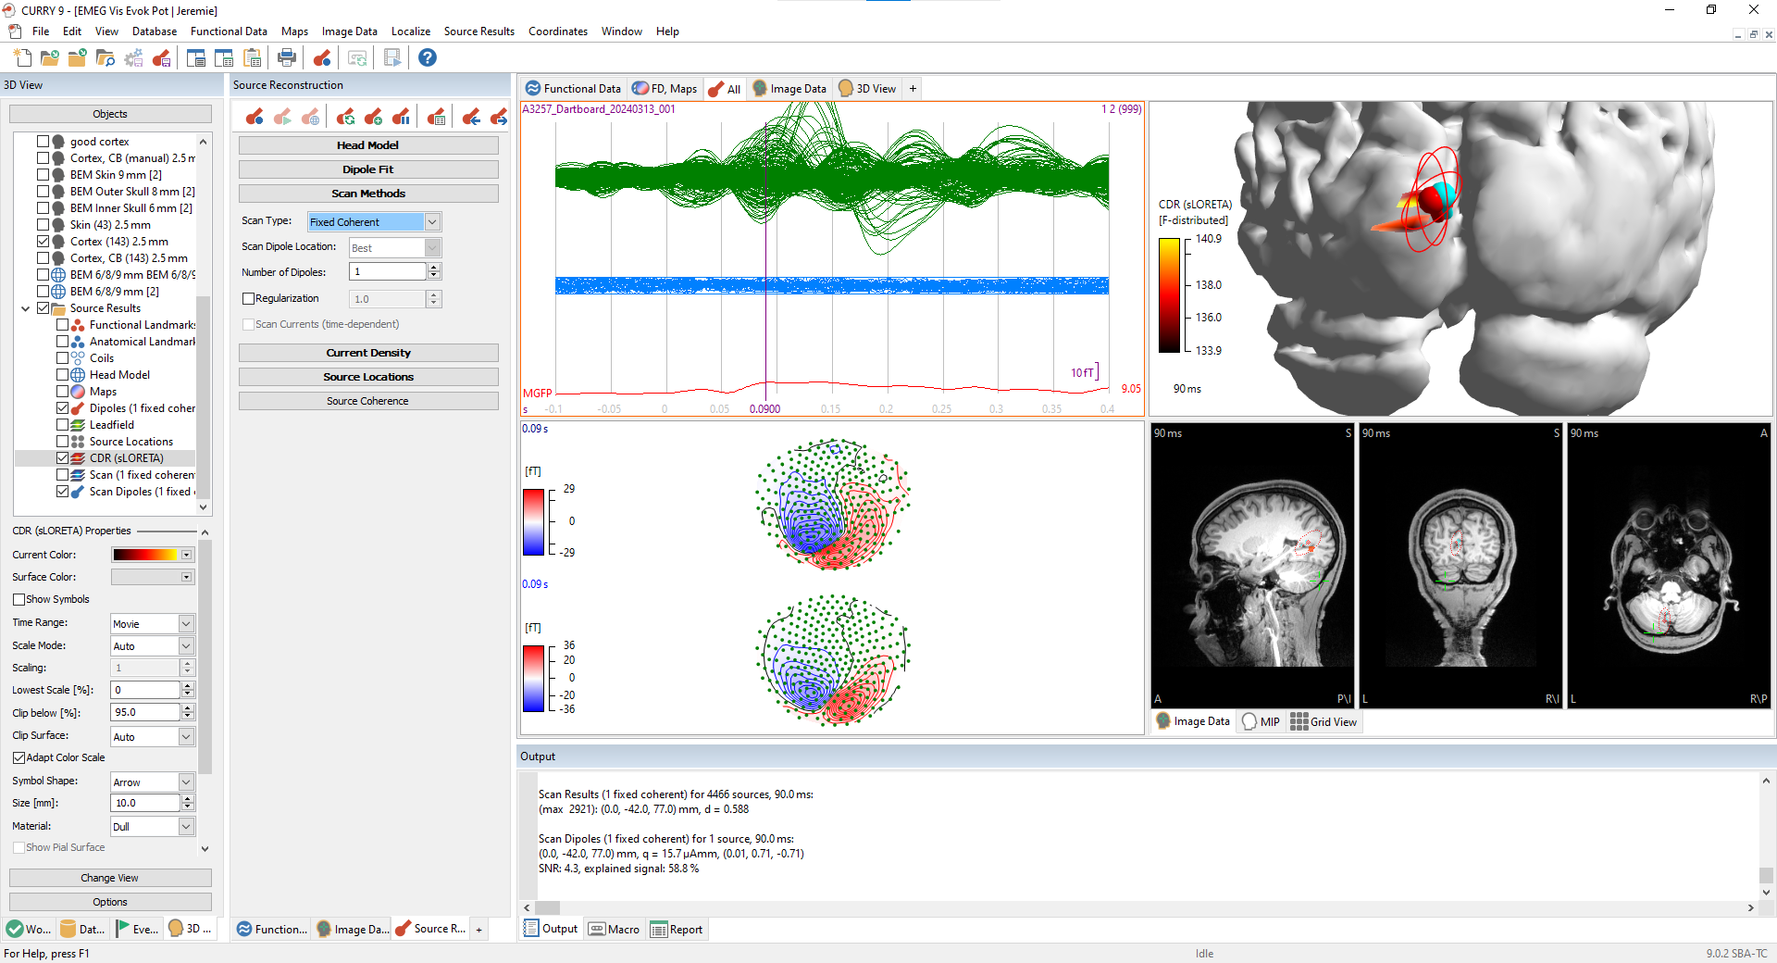
Jérémie sLORETA CDR and dipole scan

